Slide 1
Flux Training @ Cisco
Emanuele Della Valle
Prof. @ Politecnico di Milano
Founder & Partner @ Quantia Consulting
Marco Balduini
Founder & CEO @ Quantia Consulting

Slide 2
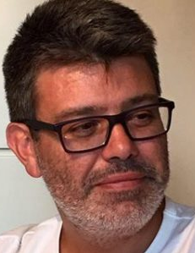
Emanuele Della Valle, PhD
Associate Professor | Politecnico di Milano
Founder & Partner | Quantia Consulting
Expert in semantic technologies and stream computing
Brander of stream reasoning: an approach to master the velocity and variety dimension of Big Data blending stream processing and AI
+20 years experience in innovation and research projects
Contact
emanuele.dellavalle@quantiaconsulting.com
@manudellavalle
http://emanueledellavalle.org
http://www.quantiaconsulting.com

Slide 3
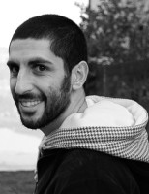
Marco Balduini, PhD
Founder & CEO | Quantia Consulting
Expert in data processing, data integration and data science technologies
Main contributor of the C-SPARQL Engine, author of Streaming Linked Data framework and FraPPE ontology
~10 years experience in innovation and research projects
Contact
marco.balduini@quantiaconsulting.com
@balducci85
http://www.quantiaconsulting.com

Slide 4
Flux Training
Emanuele Della Valle Prof. @ Politecnico di Milano & Partner @ Quantia Consulting
Marco Balduini Founder & CEO @ Quantia Consulting

